Slide 1

ISO & GeoDCAT-AP Pilot Working Team T-1B
Drafting the Geospatial High-Value Datasets tagging good practice specification
Antonio ROTUNDO (AgID – Italy)
Jordi ESCRIU (JRC – European Commission)

Slide 2
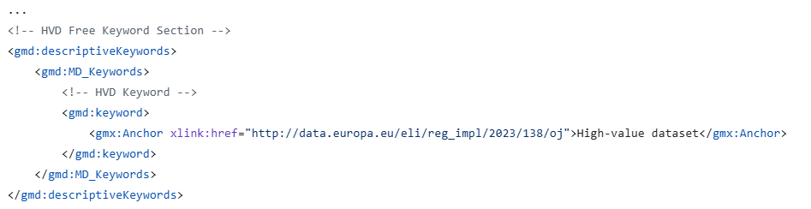

Starting point
Agreed HVD (geospatial) tagging
applicable legislation
DCAT-AP High Value Datasets
1
Example:
Keyword for citing the EU HVD Regulation

Slide 3
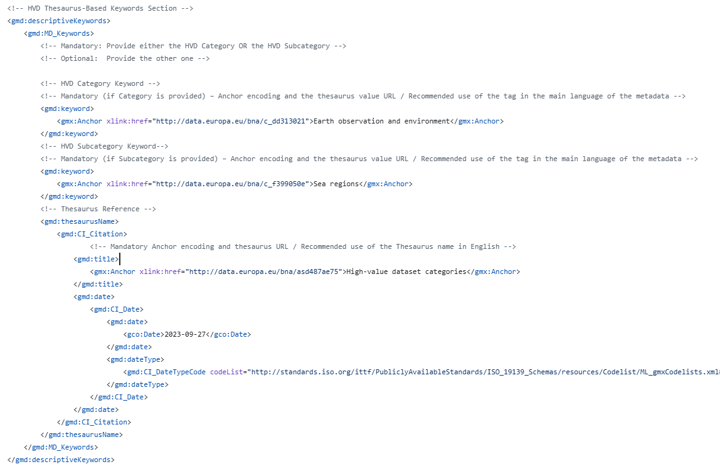
Starting point
Agreed HVD (geospatial) tagging
HVD category
DCAT-AP High Value Datasets
2
Example:
Keyword corresponding to the HVD category (or sub-category)

Slide 4
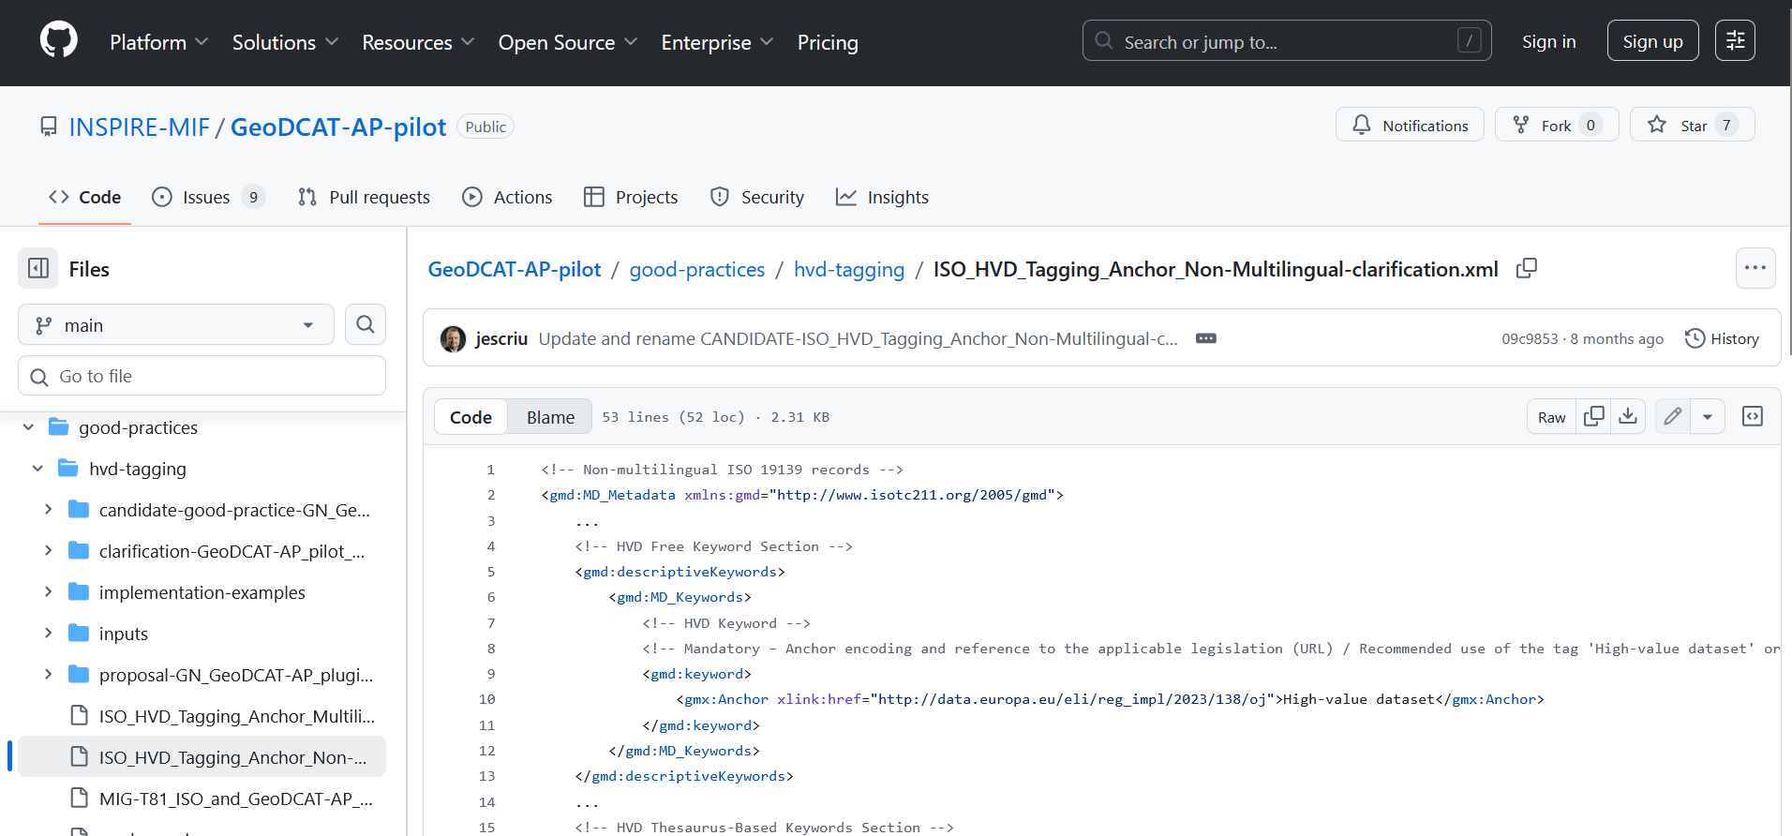
Starting point
Agreed HVD (geospatial) tagging
3
Full details of Phase 1 agreements & implementationexamples:
Available on GitHub
NON- MULTILINGUAL:
https://github.com/INSPIRE-MIF/GeoDCAT-AP-pilot/blob/main/good-practices/hvd-tagging/ISO_HVD_Tagging_Anchor_Non-Multilingual-clarification.xml
MULTILINGUAL:
https://github.com/INSPIRE-MIF/GeoDCAT-AP-pilot/blob/main/good-practices/hvd-tagging/ISO_HVD_Tagging_Anchor_Multilingual-clarification.xml

Slide 5
Task
Working teams
T-1. Support to the alignment of INSPIRE to data.europa.eu
T-1A. Management of geospatial metadata harvesting and reporting issues
A forum for discussing issues, submitted (or to be submitted) to the relevant SEMIC GitHub repositories in the scope of geospatial datasets reporting (ISO / INSPIRE to GeoDCAT-AP), including geospatial HVDs.
T-1B. Specific analysis and good practices for INSPIRE-data.europa.eu alignment
Team for performing specific analysis, discussing on and formalising common good practices in the scope of the alignment and integration of INSPIRE into data.europa.eu.
Agreement on a good practice for describing Data Services / APIs
Analysis of potential metadata information losses in the ISO-to-GeoDCAT-AP transformation
Drafting of the Geospatial High-Value Datasets tagging good practice specification

Slide 6
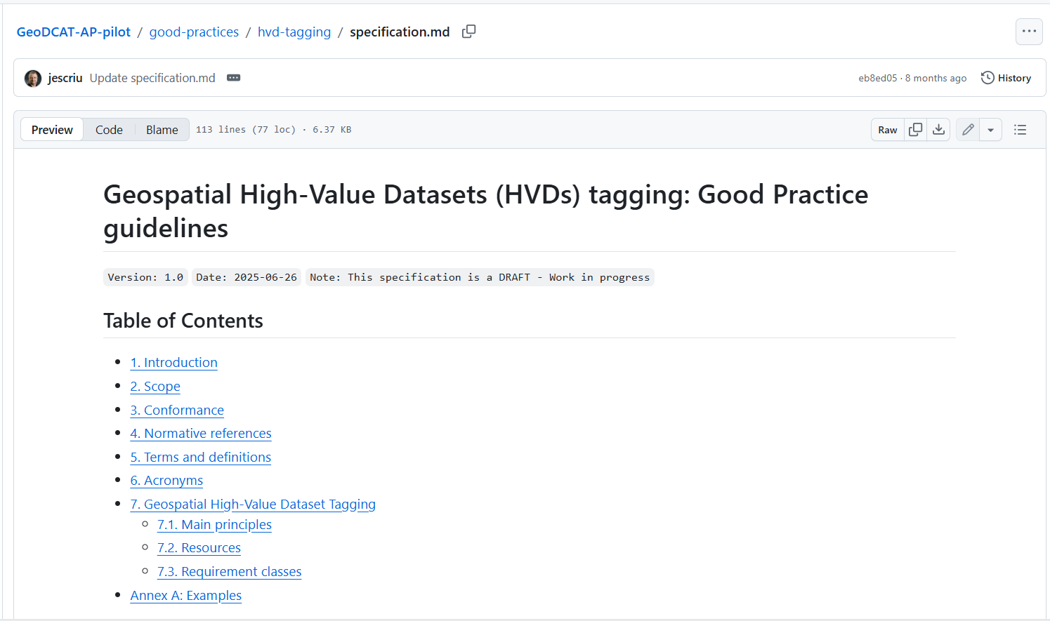
Task
Objectives
completing the drafting of a formal Geospatial High-Value Datasets tagging good practice specification
https://github.com/INSPIRE-MIF/GeoDCAT-AP-pilot/blob/main/good-practices/hvd-tagging/specification.md

Slide 7
Task
Call to contribute
We need:
implementation evidence
updated examples using the approach agreed for the good practice
more volunteers to contribute to the drafting of the specification

Slide 8
Task
Working plan
Working Team T-1B
Kick-off meeting
26 Feb.
Closing of call
for volunteers
6 Mar.
Drafting of the specification.
Final version of the specification
29 May.
February 2026
March 2026
April 2026
May 2026
Collection of
evidence / examples
31 Mar.
First draft of the specification
30 Apr.

Slide 9


Thank you!

